Slide 1
OGF Model Plan
Ellen Stokes
Sergio Andreozzi
Paul Strong

Slide 2
Model Plan Relationship
OGSA, RM, and GLUE workgroups have working relationship
  RM defines the general abstract reference model
  GLUE is a derivation of the reference model and provides the info model objects and a data model rendering in XML
    CIM is leveraged for model objects and working relationship exists with DMTF CIMCore workgroup
  OGSA defines information model architecture to maintain a corherent view among the OGF WGs, e.g. GLUE, BES, and JSDL (3-bubble diagram)

Slide 3
Relationship to other OGF WGs
BES
JSDL
SAGA
Used to describe
exposed resources
Used to express
activity requirements
Common service description
GLUE
Used to describe
exposed resources
Describes OGSA info
model architecture
GSM
OGSA RM DT
Describes general abstract model
Reference Model

Slide 4
Model Plan Deliverables
10/2007 (OGF21)
  Draft docs available for OGF21 working sessions (RM, GLUE, OGSA)
1/2008 – docs ready for public comment
  Reference model doc v1
  GLUE schema doc
  OGSA info model architecture doc

Slide 5
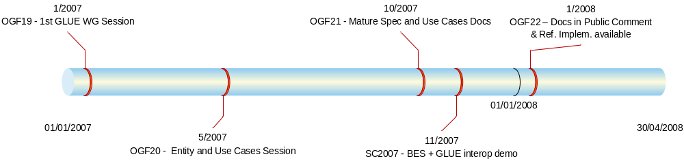
GLUE Tentative Timeline

